Slide 1





b
$$e$$
$$a_{1}$$
$$p$$
$$a_{2}$$
$$C(A)$$

Slide 3
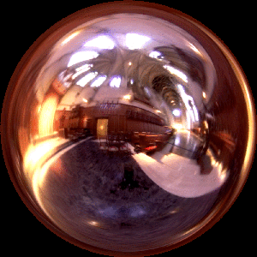

R
N
Incident Radiance
(Illumination Environment Map)
Irradiance Environment Map

